Slide 1
Lecture 3
The IP Protocol
Network Addresses and Subnet

Slide 2
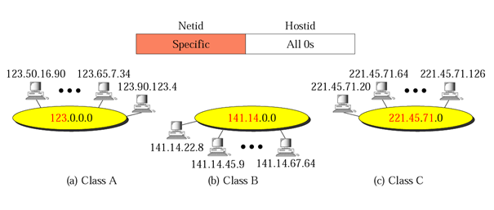
Network Addresses

Slide 3
Mask
A mask is a 32-bit binary number.
The mask is ANDed with IP address to get
  The block address (Network address)
  Mask AND IP address = Block Address
A mask is a 32-bit binary number that gives the first address in the block (the network address) when bitwise ANDed with an address in the block.

Slide 4
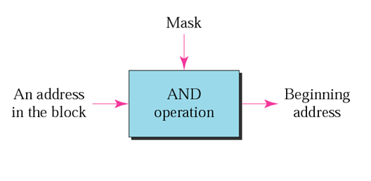
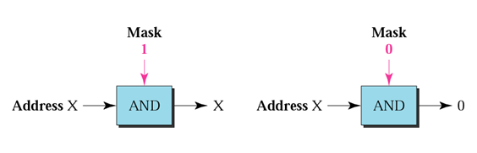
Masking Concept
AND operation

Slide 5
Network Addresses
The network address is the beginning address of each block.
It can be found by applying the default mask to any of the addresses in the block (including itself).
It retains the netid of the block and sets the hostid to zero.
Default Mask
Class A default mask is 255.0.0.0
Class B default mask is 255.255.0.0
Class C Default mask 255.255.255.0
We must not apply the default mask of one class to an address belonging to another class.

Slide 6
Problem
Given the address 23.56.7.91 and the default class A mask, find the beginning address (network address).
Solution
The default mask is 255.0.0.0, which means that only the first byte is preserved and the other 3 bytes are set to 0s. The network address is 23.0.0.0.

Slide 7
Problem
Given the address 132.6.17.85 and the default class B mask, find the beginning address (network address).
Solution
The default mask is 255.255.0.0, which means that the first 2 bytes are preserved and the other 2 bytes are set to 0s. The network address is 132.6.0.0.

Slide 8
Problem
Given the address 201.180.56.5 and the class C default mask, find the beginning address (network address).
Solution
The default mask is 255.255.255.0, which means that the first 3 bytes are preserved and the last byte is set to 0. The network address is 201.180.56.0.

Slide 9

Example
ellington.cs.virginia.edu
Network id is: 128.143.0.0
Host number is: 137.144
Network mask is: 255.255.0.0
Prefix notation: 128.143.137.144/16
        Network prefix is 16 bits long

Slide 10
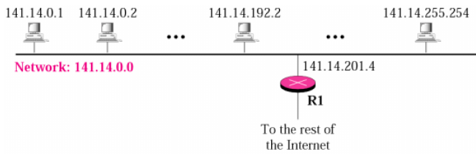
Subnet
IP addresses are designed with two levels of hierarchy. Two-layer hierarchy is not appropriate for large networks with Class A and Class B addresses.
The network above (network 141.14.0.0) uses class B addressing. This network has 256×256=65536-2 =65534 hosts on a same physical network.
Note: The first Address is the Network Address and the last Address is the Broadcast Address. They are reserved and cannot be assigned to any node.

Slide 11
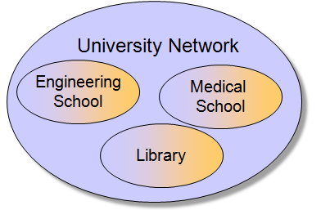
Cont.
The subnetting in the computer network divides a bigger network IP address space into smaller independent address spaces. Organizations have multiple networks which are independently managed
  Add another level of hierarchy to the IP addressing structure known as subnetting.

Slide 12
Cont.
Subnetting is done by borrowing bits from the host part and add them to the network part
Site identified by network prefix
Physical net at site identified by part of suffix
Host on the net identified by remainder of suffix

Slide 13
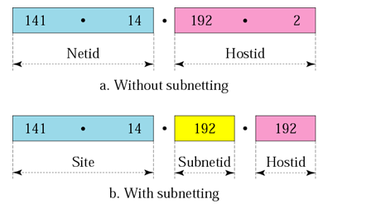
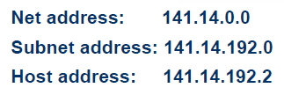
Addresses in a network with and without subletting
  Note: in this case, 16-bit host portion is divided into two 8-bit fields.

Slide 14
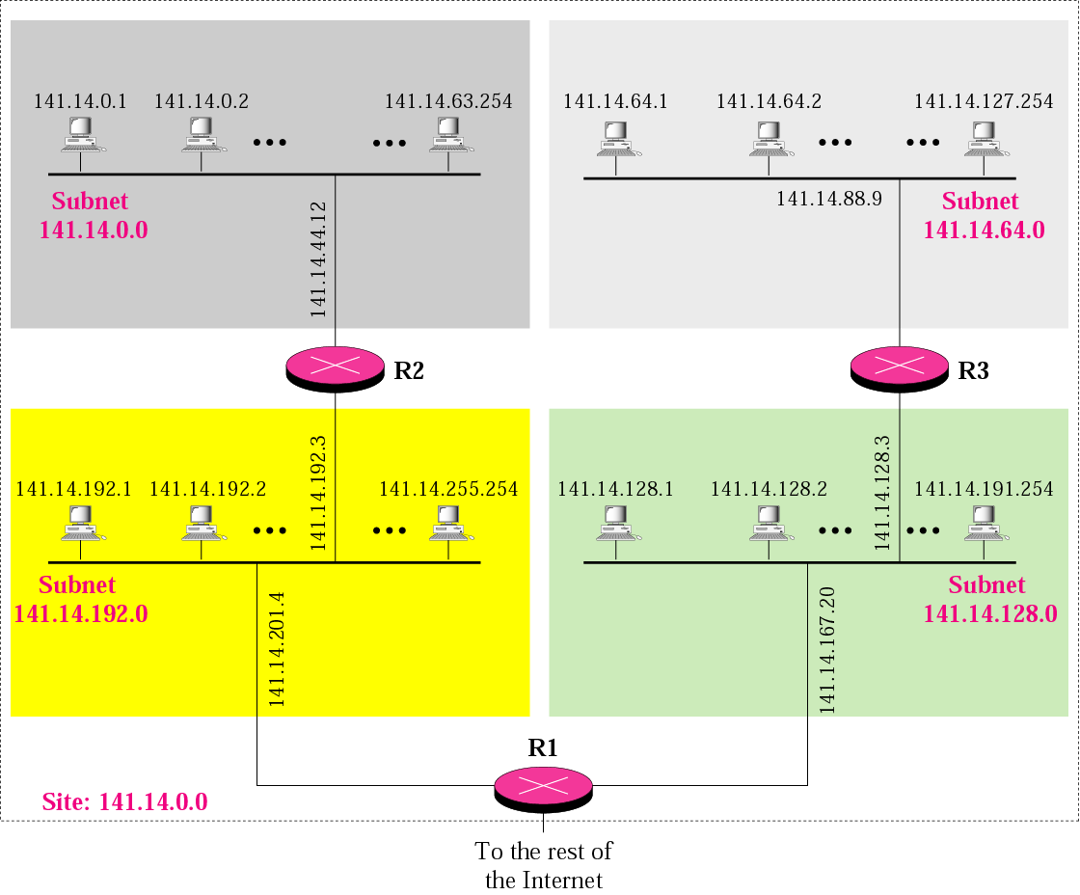
A network with three levels of hierarchy (subnetted)

Slide 15

Cont.
  A LAN with 55534 hosts is too big. An additional level of hierarchy is required in order to break the large number of hosts into several smaller groups. For example, we can break the hosts into 4 groups (subnets).
  The Gateway Address is the Address of the router where the packet should be sent in case the destination host does not belong to the same subnet.

Slide 16
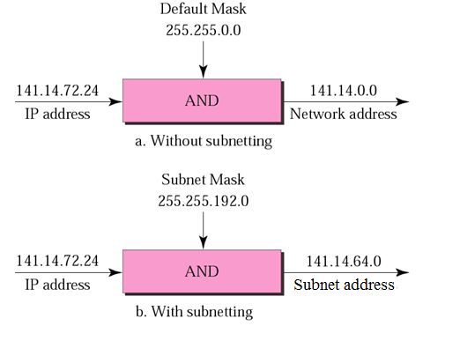
Mask and Subnet Mask
  IP Address and Subnet Mask define the Subnet.

Slide 17
Finding the Subnet Address
Given an IP address, we can find the subnet address the same way we found the network address. We apply the mask to the address. We can do this in two ways:
straight
short-cut
Straight Method
In the straight method, we use binary notation for both the address and the mask and then apply the AND operation to find the subnet.

Slide 18

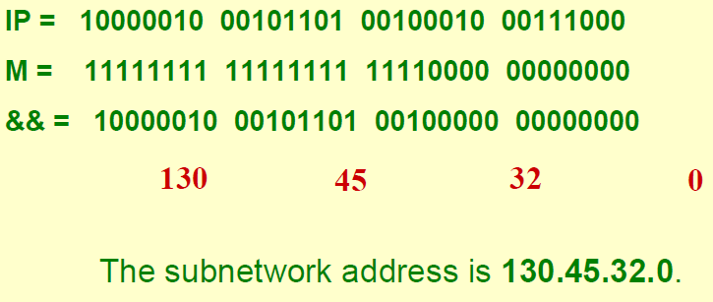
Straight Method Example
Solution

Slide 19
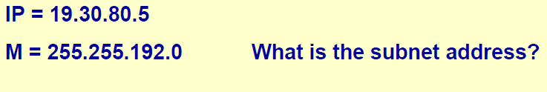
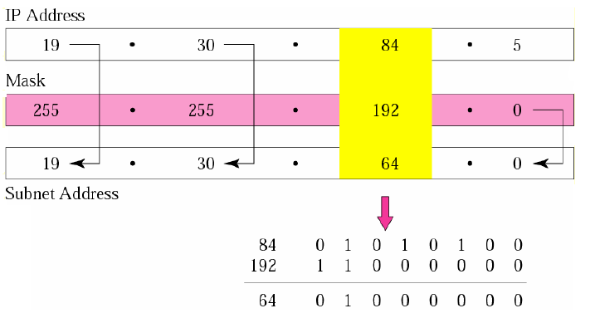
Short-Cut Method Example
If the byte in the mask is 255, copy the byte in the address.
If the byte in the mask is 0, replace the byte in the address with 0.
If the byte in the mask is neither 255 nor 0, we write the mask and the address in binary and apply the AND operation.
Problem
Solution

Slide 20
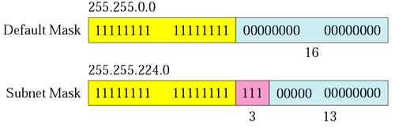

Comparison of a default mask and a subnet mask
The number of subnets must be a power of 2.

Slide 21
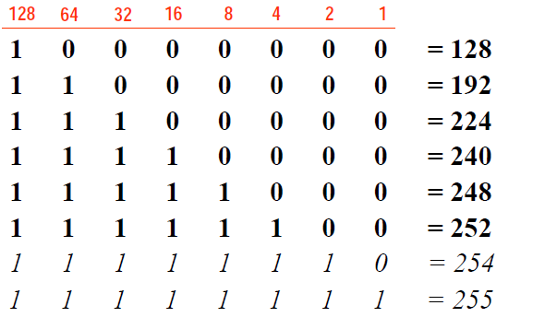
Possible netmask values

